Slide 1

WHICH ONE DO YOU LIKE?
THE BLUE SKY
OR
THE DIRTY SKY

Slide 2
WELCOME!
Have A Nice Day!
Ali Bagherzadeh

Slide 3
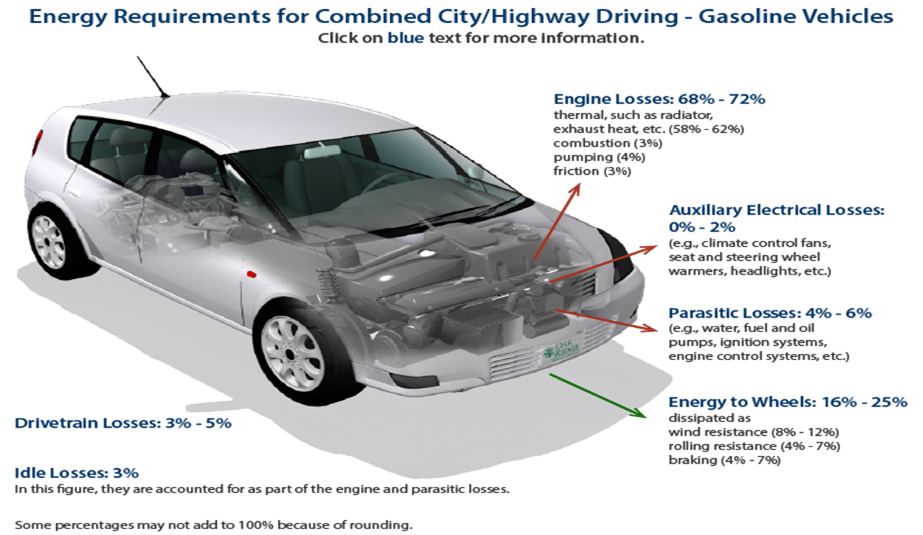
It’s Time To
Do Something
Technologies are rapidly advancing,. roads are flooded with vehicles, helping us to commute and for goods transportation, back of the scene, a lot of research and studies are conducted to come up with the best possible ideas and design, but the comfort and advancement come at the cost of more energy required to power the vehicle systems and in turn more CO2 emissions. The Government of many countries has also implemented regulations so that companies take utmost care that their automobile should have the emissions well within the allowed limits.

Slide 4
Ever Wondered how companies employ ML to predict CO2 emissions of a newly proposed vehicle, so in order to bind with government regulations?

Slide 5
Using Machine learning
Machine learning found its way to the industry via this route, instead of explicitly programming the software, we can train a "model", which can predict the CO2 emissions based on specified "parameters", which we are going to see

Slide 6

Predicting CO2 emissions of a vehicle using Regression
DATA
Cleaning DATA
Using Machine learning
Python libraries
Find best
machine learning
algorithms
Result
Around 1000
Vehicle which are made in 2022
.

Slide 7
The python Libraries which are being used in the implementation are:
1
Numpy
2
Matplotlib
3
Scikit-learn
4
Pandas

Slide 8
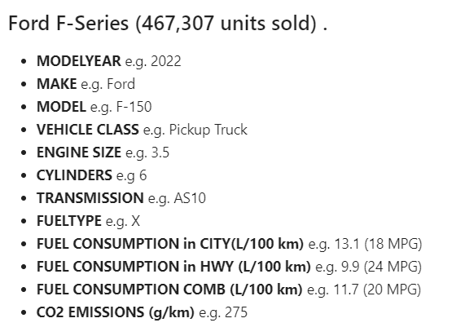
Pandas and the dataset
df = pd.read_csv(r'FuelConsumption.csv’).
I have downloaded a fuel consumption dataset, `FuelConsumption.csv`, which contains model-specific fuel consumption ratings and estimated carbon dioxide emissions for new light-duty vehicles.
some features that I want to use for regression
The NO 1 Bestselling Car of 2022 in USA (So Far) from https://www.caranddriver.com
import pandas as pd
.
import matplotlib.pyplot as plt
from sklearn import linear_model
import numpy as np
Fuel consumption ratings - Open Government Portal (canada.ca).

Slide 9

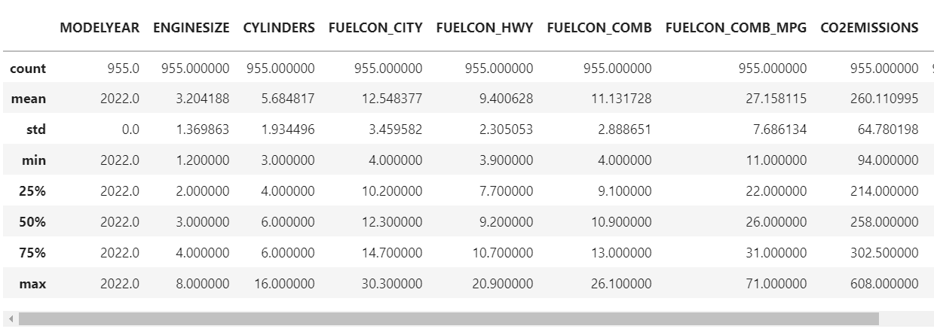
summarize the data
df.describe()

Slide 10

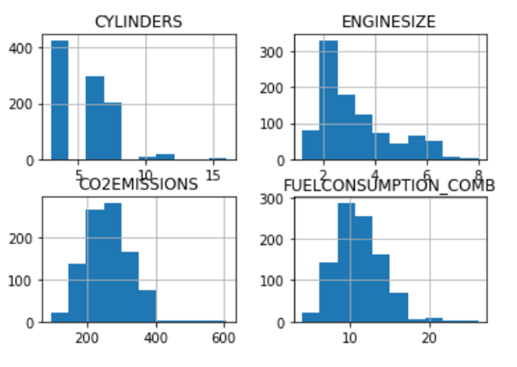
If we plot each of these features:
viz = cdf[['CYLINDERS','ENGINESIZE','CO2EMISSIONS','FUELCONSUMPTION_COMB']]
viz.hist()
plt.show()

Slide 11
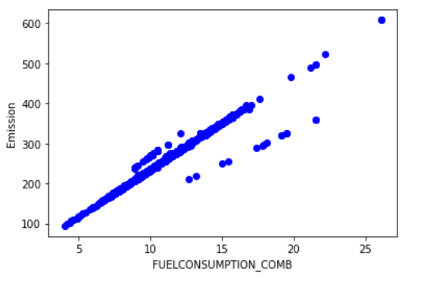
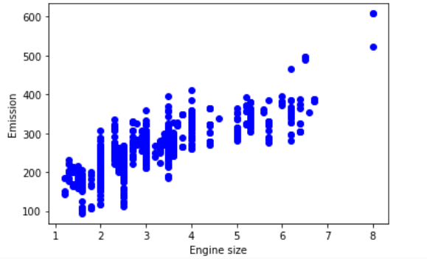
Emission values with respect to
Engine size and Fuel Consumption
plt.scatter(cdf.FUELCONSUMPTION_COMB, cdf.CO2EMISSIONS, color='blue')
plt.xlabel("FUELCONSUMPTION_COMB")
plt.ylabel("Emission")
plt.show()

Slide 12
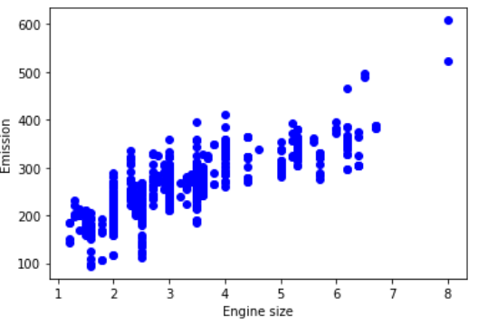
Creating train and test dataset
Split my dataset into train and test sets.
80% of the entire dataset will be used for training
20% for testing.
By create a mask to select random rows using **np.random.rand()** function:
msk = np.random.rand(len(df)) < 0.8
train = cdf[msk]
test = cdf[~msk]
Train data distribution:

Slide 13
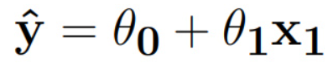
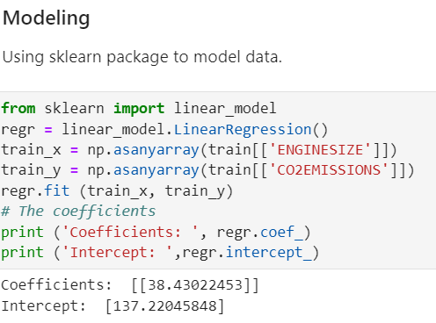
Simple Regression Model
04
Coefficient and Intercept in the simple linear regression,
are the parameters of the fit line.
03
01
02

Slide 14
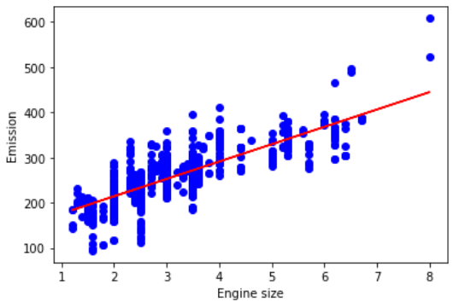

Results
Plot the fit line over the data:
after I compared the actual values and predicted values to calculate
the accuracy of a regression model:
Evaluation Result is:

Slide 15

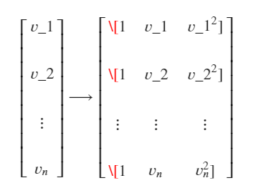

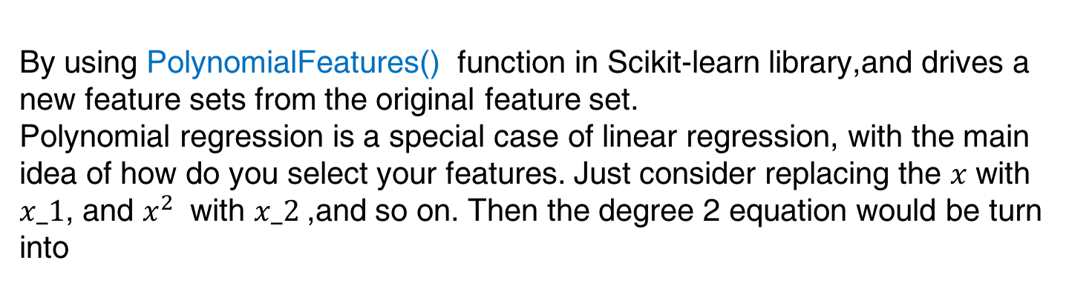
Polynomial Regression
Sometimes, the trend of data is not really linear, and looks curvy!!
let's make 2-degree polynomial:
Now, the question is: how we can fit our data on this equation while we have only x values, such as “Engine Size”?
By using PolynomialFeatures() function in Scikit-learn library,and drives a new feature sets from the original feature set.
Polynomial regression is a special case of linear regression, with the main idea of how do you select your features. Just consider replacing the $x$ with $x_1$, and $x^{2}$ with $x_2$,and so on. Then the degree 2 equation would be turn into
Now, we can deal with it as 'linear regression' problem

Slide 16
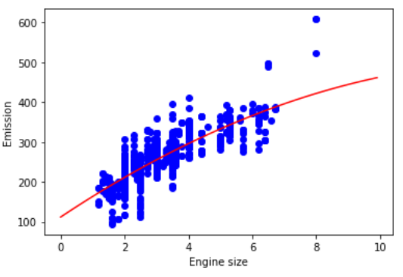

Results
Evaluation Result is:
Plot the fit line over the data:

Slide 17
Multiple Regression Model
In reality, there are multiple variables that impact the Co2emission. When more than one independent variable is present, the process is called multiple linear regression.
An example of multiple linear regression is predicting co2emission using the features like:
FUELCONSUMPTION_COMB,
Engine Size
Cylinders of cars
The good thing here is that multiple linear regression model is the extension of the simple linear regression model.

Slide 18
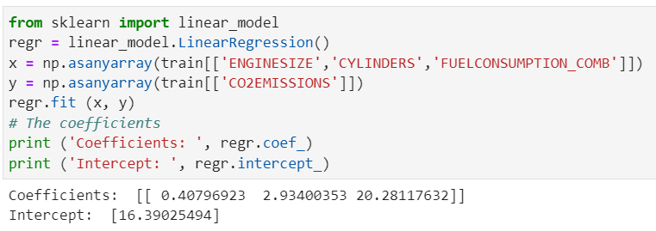
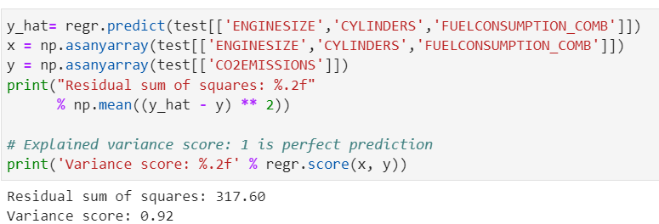
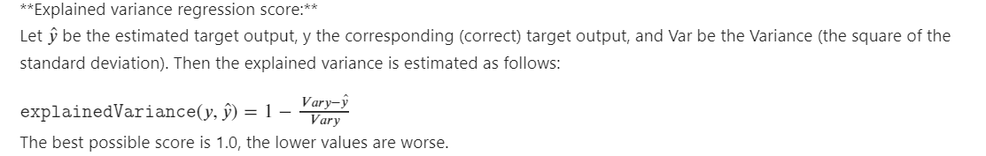
Results

Slide 19
1) Simple Regression Model
2) Polynomial Regression
3) Multiple Regression Model
CO2
0.92
0.70
0.68
1
2
3

Slide 20
Blue Sky is Coming…

